Slide 1

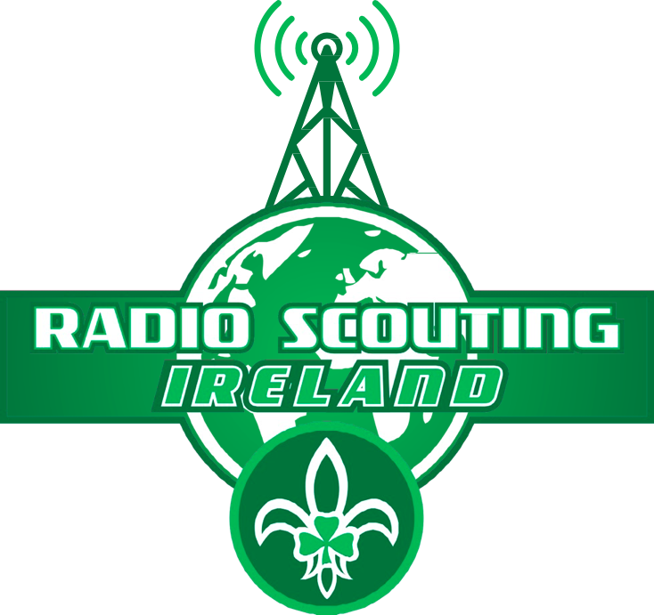
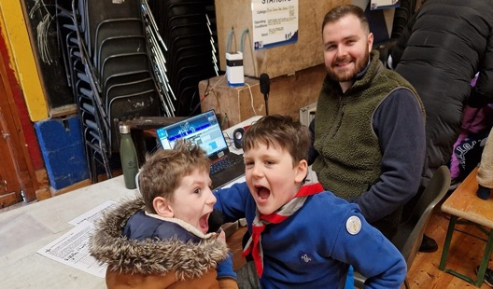

Welcome to the Introduction to Radio Scouting and the Radio Scouting Skills Programme level 1 &2 Leader training

Slide 2
Today’s Agenda
Time | Topic | Lead
09.45-10.00 | Registration, Tea and coffee, introductions | ALL
10.00 - 10.20 | Introduction to Radio Scouting, JOTA-JOTI & YOTA | JH & AC
 | Radio Scouting Ireland's role & Radio Scouting Skills Program
 | Introduction to Ham Radio
10.20 - 11.00 | Radio scouting stage 1 | AC
11.00 - 11.15 | Break
11.15 - 12.00 | Simple radio activities: X's & O's, Hang Man and Lego games | ALL
12.00 - 13.15 | Lunch
13.15 -14.15 | Radio code hunt Game | AC
14.15 - 15.15 | Radio scouting Stage 2 Electric circuits, EMF and compass activity Morse code activity | JH AC
15.15- 16.00 | Mission Impossible HF radio game | All
16.00-16.30 | Wrap up, Q&A and feedback | All

Slide 3
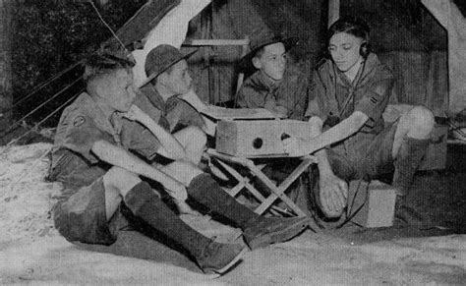
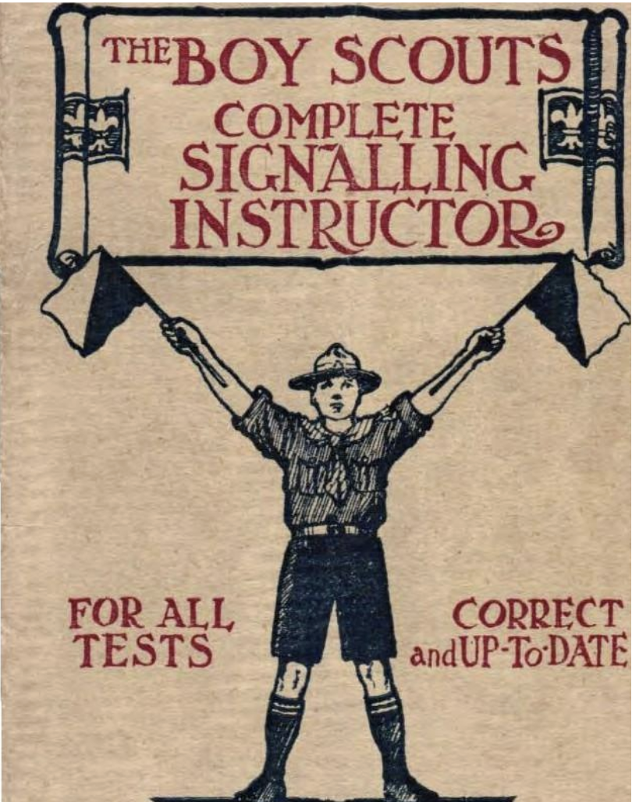
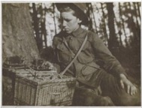






Radio Scouting/Radio Guiding
Radio Skills have been a fun and educational part of scouting and guiding since circa 1914.
Ham Radio or Amateur Radio is a big part of Radio Scouting
BP wanted scouts & Guides to understand they are part of a bigger world
The biggest annual scout and guide event is JOTA-JOTI
Many countries have well-established radio scouting programs
Radio Scouting Ireland (RSI) was set up to support Irish scout and guide groups who want to take part in JOTA-JOTI and do radio/STEM. There are lots of free resources at www.radioscouting.ie/resources
BADGES!!! Skills and Participation badges:
  Radio Scouting skills program S1-S9 up to license level
  Licensed Operator & Special Interest badges
  JOTA-JOTI badge – Biggest annual scout and guide event

Slide 4
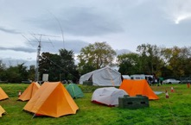
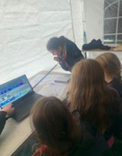
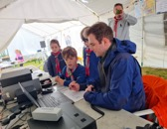
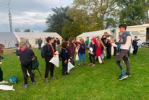
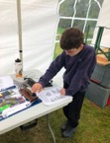
Jamboree On The Air - JOTA
Largest Scouting Event in the World since 1957!
~1-2 Million Scouts operating ~ 13,500 stations in ~ 150 countries take part each year in October
Underpins the global nature of scouting, scouts can gain perspective on other countries, other, cultures and other Scouting programs --- by talking to other Scouts around the world
Introduces Scouts to the fun and technology of amateur radio & radio scouting
Learn and or improve a new skill
Earn a JOTA-JOTI badge
You might end up with a great lifelong hobby
It might even be the start of a great career!

Slide 5



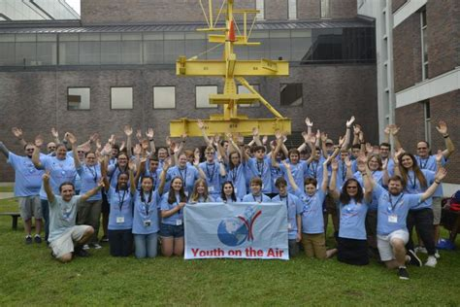
A global movement connecting teens & young adults in amateur radio
Mission: engage young people (≈ages 15–26) in amateur radio through hands‑on activities
Why it matters: skills, friendship, service & STEM career pathways
How:
Train‑the‑Trainer & local youth events
  Summer Camps (international & regional)
  December YOTA Month (special callsigns & awards)
  YOTA Contest (3 rounds yearly)
  Big synergies and parallels with scouting
Sources: ham‑yota.com • youthontheair.org • IARU Region 1

Slide 6
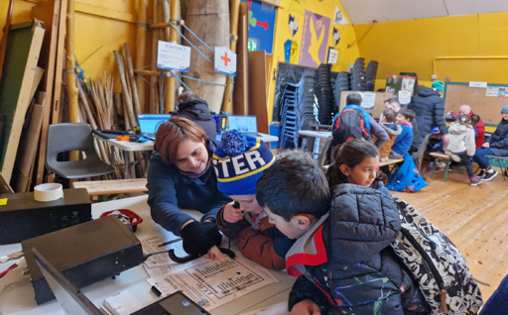
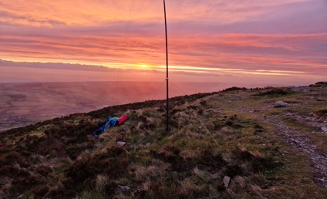
Radio Scouting Ireland's Role
Radio Scouting Ireland – Strategic Ovbjectives 2022-2025
Develop fun radio, communications and electronics activities that are easily achievable by Scout troops around Ireland at their dens and the National Scout Centres - See www.radioscuting.ie
Support scout troops with training
Support national Scout, Guide and Youth events
Development and support the Radio Scouting Program (S1-S9), to support Scouts and Scouters to achieve a solid understanding of science, technology, radio, electronics, operations and regulations.
Lobby and support the establishment of an Irish novice license regime suitable for youth members.
Develop a sponsorship program to create a network of excellent STEM/Radio shack facilities at the main Scout Centres around Ireland
Radio Scouting Ireland also complete Garda vetting and safeguarding training for all our volunteers

Slide 7
https://www.youtube.com/watch?v=8x6x_6mDVlQ
Amateur Radio a Hobby for the 21st Century
https://vimeo.com/325220441
Notes:
What is scouting all about
Talk about the value of what we do, getting kids out doors, providing and fun place for kids that don’t fit into the world of sport
How to get involved, leader, parents and friends
We are getting bigger
we have recrutied from within (Fionn)
Need leaders in scouts and venturers

Slide 8
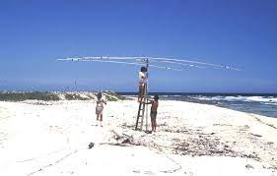

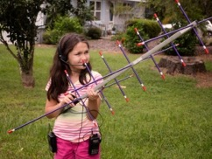
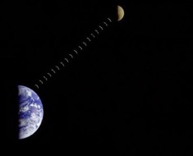
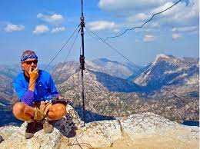
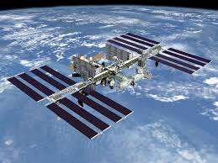


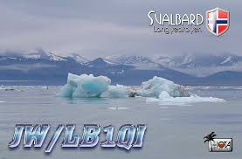
EME (Earth-Moon-Earth)
Contacts all around the world!
Antenna building
Building own radio/electronics
Contesting – Radio sport
Rag chewing (chat)
Direction finding
Voice, Morse (CW) Packet/Data modes
DX communication
DX-pedition
Earth-Moon-Earth
Emergency communications
Morse code
Operating awards
Portable operation
QRP operation
QSL card collection
Satellite communications
Special event stations
Television
Slow scan Television
IOTA -Islands
SOTA -Summits
POTA - Parks
And many more!!!
Ham Radio - lots of fun & interesting things to do!
IOTA – islands On The Air & DXPEDITIONS
Satellite communication
SOTA – Summits On the Air
ISS & ISS repater
Notes:
On VHF contacts are normally line of sight only.
Can be extended to 1000 miles or more with Tropo, various scatter modes
How can we make contacts further out?

Slide 9
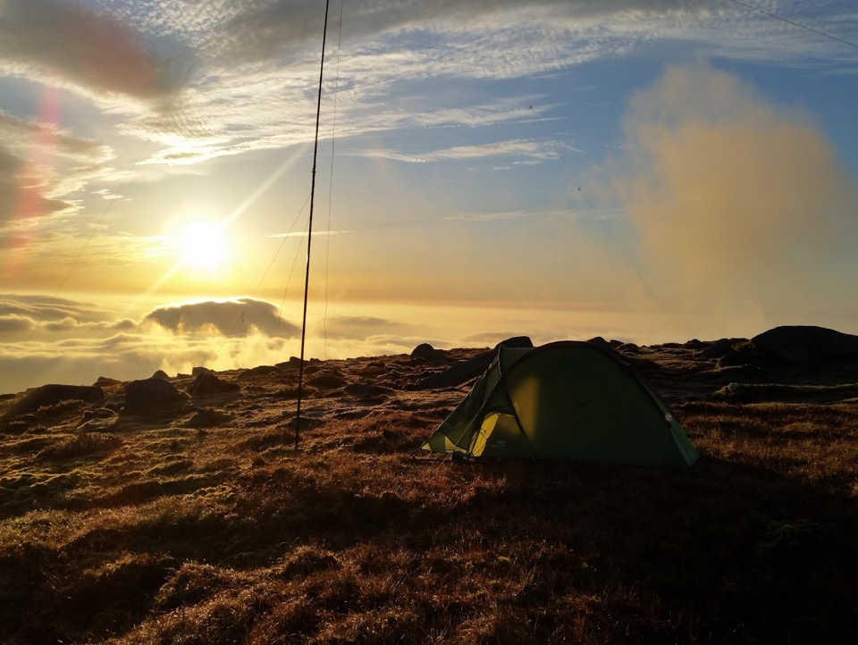
Radio Scouting Skills Stage 1

Slide 10

Radio Scouting Skills program, modelled on the Excellent SI adventure skills Programs
Radio Skills Program very aligned with SI adventure skills program but it is NOT an official SI adventure Skill. It does count as a LFYT module.
Presented as Statements of competency - I know how, I can do, etc.
Skills requirement outlines the details of knowledge and experience a Scout is expected to display to fulfil the Competency Statement.
Stages are not aligned to Sections
Competencies need to be assessed.
Stage 1 aims to introduce the skill to where the scout can take an active part

Slide 11
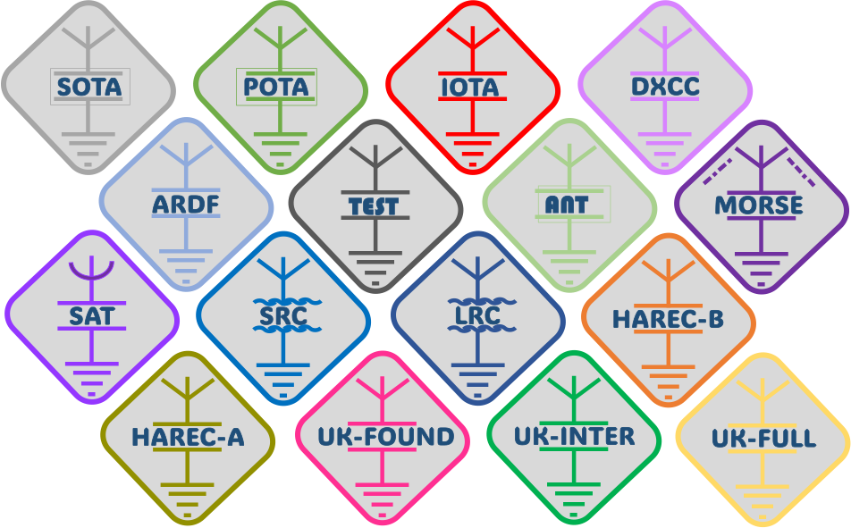
Special Radio Interests/Skills
Between program levels scouts or guides have had to work particularly hard to attain the evidence to support a specific skill or competency as part of their personal progression.
Attaining these skills require a level of commitment and hard work. To recognise this commitment and hard work, alongside the Stage 1-9 badges are a set of complimentary Radio Scouting Special Interest/Special competency badges

Slide 12
Stage 1 - Competency Statements
I can name the things I know that use radio waves
I know my parents/guardian/ICE contact phone number and can dial it on a mobile phone
I know the difference between Commercial and Amateur radio
I can name some radio stations I can hear from my home/den/car
I Know why Amateur Radio is a licensed activity
I know some aspects of the language of radio (Q code , phonetic Alphabet, callsigns), I know what the callsign prefix for my own country is and I can spell my name using the phonetic alphabet
I know what morse code is
I know how to use a walkie talkie properly
I understand the limitations of using a walkie talkie

Slide 13
I can name the things I know that use radio waves
Scouts should discus the things they know that use radio waves
Discussion should include similarities and differences between them including range and operation.
E.g. Walkie Talkies, Car radio, TV, WiFi, GPS, Bluetooth, Radar, baby monitors, satellite dishes
Range: Over what distances do they work? How far away do you have to go from a phone for a Bluetooth speaker to stop working?
Two – way: What things are using two way communication and which are one way?

Slide 14
I know my parents/guardian/ICE contact phone number and can dial it on a mobile phone
Scouts should know their ICE contact number
Scouts can demonstrate that they can use a mobile phone to call someone. They can borrow a scouters phone to call another scouter.
Scouts should know the Emergency Services Numbers
Scouts should know that even if they don’t have a mobile signal they may still be able to call the Emergency Services

Slide 15
I can name some radio stations I can hear from my home/den/car
The Scout should experiment with an FM or AM radio in their den and be able to tune around to different stations.
Listen to some of the stations for a while and identify their name and where they broadcast from.
Create a ‘Band Plan’ of some of the stations you can hear. List:
  The frequency the operate on
  Their name
  Type of programming (news, music, sports etc.)
If FM and AM radios are available compare and contrast the stations heard

Slide 16
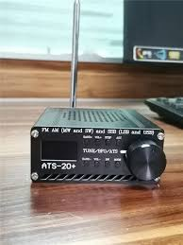
I know the difference between Commercial and Amateur radio
Scouts should be introduced to listening to Amateur Radio. This can be done with a amateur radio set, an RTL-SDR, or a web based SDR.
Scouts should discuss the difference between these communications and the commercial stations they listened to.
  Amateur radio: people talk to each other, or send 2 way messages, signals not as strong, signals not a clear, no music, no making money
  Commercial Radio: One way communication, stronger signal, often contains music

Slide 17
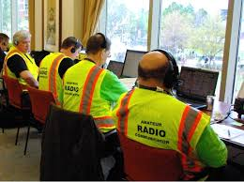
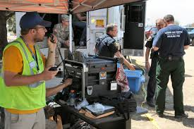
Scouts should know Amateur radio requires a license
Why is Amateur Radio a licensed hobby?
Using radio transmitters can be dangerous.
  Can cause interference to flight control, blue-light services etc.
  Can cause shock and burns
  Governments want to ensure licensed amateurs know what they are doing!
Licensed amateurs are a very important resources during natural disasters in many countries. Governments need to know who their amateurs are in case of emergencies. Licensed Amateurs often provide back-up communications to cellular, internet and blue light communications in disaster scenarios.
Notes:
On VHF contacts are normally line of sight only.
Can be extended to 1000 miles or more with Tropo, various scatter modes
How can we make contacts further out?

Slide 18
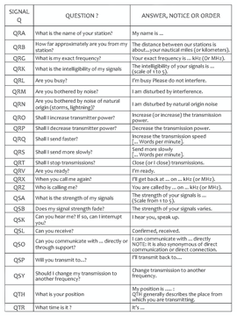
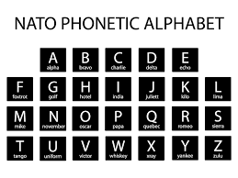
Scouts should know the language of radio
Many hobbies and sports have their own language words & code for example Scouts have Jamboree’s, woggles, neckers, Moots etc, golf has birdies, bogies, Eagles, holes in one, fades, slices etc.
Because radio reception can be very variable hams regularly use code to help with effective and accurate communication
For example:
  We use Q-code, Morse Code, The phonetic Alphabet
  A basic contact is called a QSO!
  To call on the air we say CQ CQ maybe short for Seek You Seek You!
  We use call signs which identify the radio station and country for example EI3ISB EI10JOTA
Would anyone like a go at phonetically spelling and guessing the country of these following call signs?
FR9AA IK2VCV VK7AC DL4TP ZL4AD SP9CQ
Q Codes & Shorthand
QSO – A call with another station
QSL? – Can you hear me
QSL QSL – Yes I heard you
Your QTH – Your Location – Dublin
QRZ? – Who is calling me?
73 – Best wishes
You are 59 – I Hear you loud and clear

Slide 19
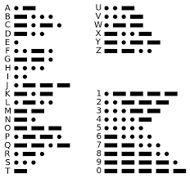
Scouts should know what CW/Morse code is
Morse code, often refered to as “CW” (Continuous Wave) is named after it’s inventor Samuel Morse is a way of sending messages efficiently using simple communications devices.
The first digital signalling system
Morse code is made up of “dit” (dot) and “dah” (dash). The duration of a dah is three times the duration of a dit.
Below is a list of morse codes for the alphabet, numbers and punctuation.
There are morse code competitions and a world championship – mostly won by young people!
https://www.tiktok.com/@hamradioworld/video/7401288374620917023
19

Slide 20
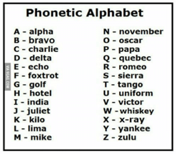
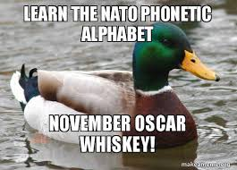
I can spell my name and other words using the phonetic alphabet
Scouts should be familiar with the phonetic alphabet and be able to spell their name using it.
There are a variety of games that can be used to teach this skill
Lets play some games!

Slide 21
Demo - How to use a Walkie Talkie
PTT - Push to talk button - wait 1 second before talking/Calling CQ
Introduce yourself to the other side - Name - Spell phonetically - Name
Say ‘over’ after each transmission
Say “again again, over ” if you need then to repeat

Slide 22
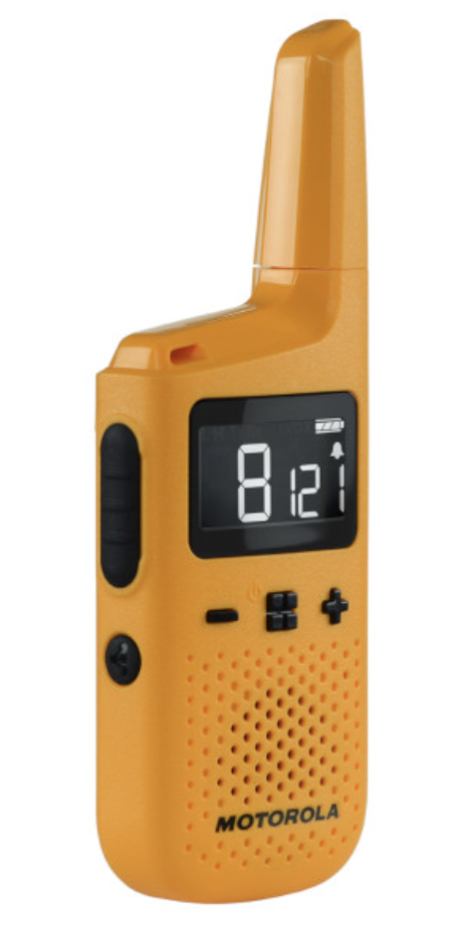
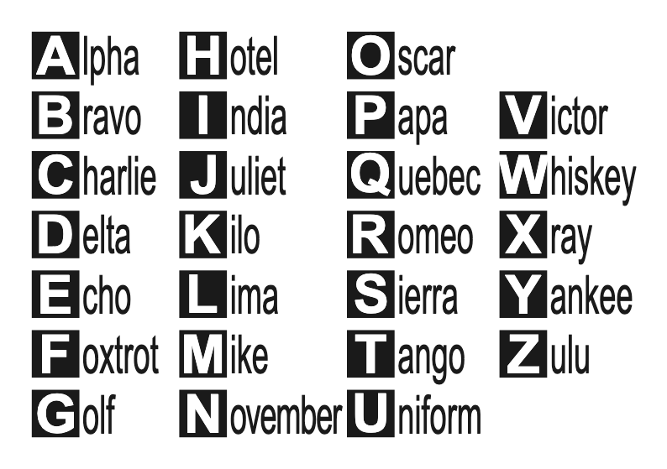
KEY POINTS
PRESS PTT BUTTON
WAIT A SECOND BEFORE TALKING
INTRODUCE YOURSELF
SPELL PHONETICALLY
SAY OVER!
SAY AGAIN, AGAIN, OVER IF NEEDED

Slide 23


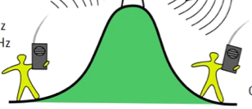

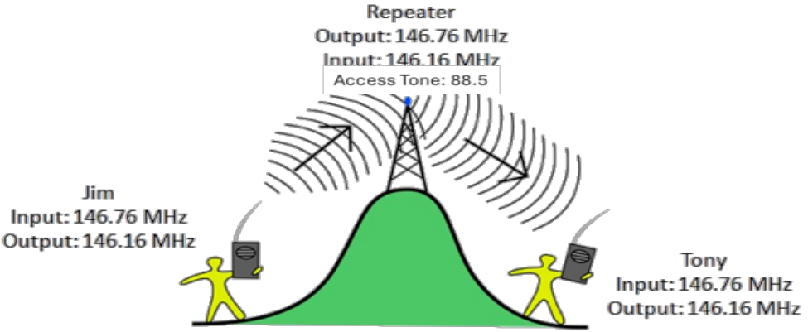
Limitations of Walkie Talkies,
VHF, UHF, & Repeaters
Very high frequency (VHF) and Ultra High Frequency communications devices are for local communication Typically 1-5 kilometers but can be up to 50-100km LOS and more under extreme propagation conditions
There needs to be a reasonably clear path between the transmitting and receiving stations Mountains, hills and buildings may block the signal partially or completely
A Repeater placed on a high site can get around this limitation and greatly increase the range of communications by repeating the signals i.e. Re-transmitting the signal received on a different channel/frequency
The radio’s need to be configured to operate in repeater mode to:
  Listen on one frequency and transmit on another
  Sometimes to send tones at the start of the transmission to ‘open’ the repeater
Can you guess why the signal needs to be re transmitted on a different frequency?

Slide 24
Lets play! – Learn by doing
Pair into groups of two or more, read the game instructions and have some fun while learning to use the walkie talkies, sometimes referred to as handie talkies!
X’s & O’s
Hangman
Lego
Battleships

Slide 25
So what did you learn?

Slide 26
Lunch Break

Slide 27
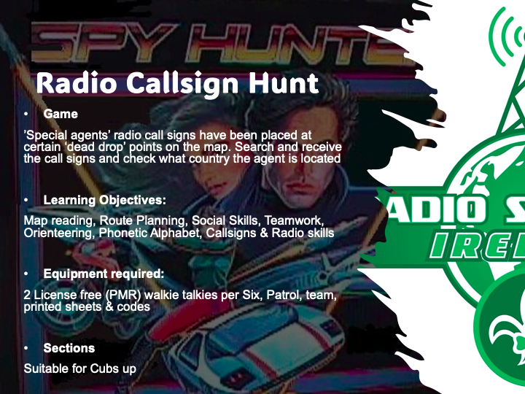
Lets playmore! – Learn by doing
Pair into groups of two or more, to play!

Slide 28
Callsign Cards
 | Location 1 |  | Location 2 |  | Location 3 |  | Location 4 |  | Location 5 |  | Location 6 |  | Location 7 |  | Location 8
 | EI3IT |  | DH1MM |  | JA2KGH |  | G6EKB |  | F6HRP |  | BG0BBB |  | EA3AR |  | CE0Y
 | EI3IX |  | DH1PAN |  | JA3ADW |  | G6INU |  | F6KOP |  | BG0CAB |  | EA3ARB |  | CE2SV
 | EI3IXB |  | DH1PS |  | JA3ALY |  | G6LKB |  | F8AEJ |  | BG1UG |  | EA3ATD |  | CE3BT
 | EI3JB |  | DH1RGS |  | JA3DAZ |  | G6LSO |  | F8AIP |  | BG2AUE |  | EA3BEM |  | CE3JBD
 | EI3JHB |  | DH1TT |  | JA3EGE |  | G6NNS |  | F8AOF |  | BG2QMO |  | EA3BP |  | CE3VBK
 | EI3JRB |  | DH2NJS |  | JA3FHL |  | G6NYG |  | F8BON |  | BG4LSA |  | EA3BR |  | CE4HUS
 | Location 9 |  | Location 10 |  | Location 11 |  | Location 12 |  | Location 13 |  | Location 14 |  | Location 15 |  | Location 16
 | RW6FY |  | S50XX |  | SV1CNS |  | PY2DV |  | ON5UN |  | NA8V |  | LX1CC |  | M6UIT
 | RW9JZ |  | S51CK |  | SV1CQN |  | PY2EIO |  | ON6FDP |  | NC1CC |  | LX1FF |  | M6UKZ
 | RX3AM |  | S51DD |  | SV1DZB |  | PY2ERA |  | ON6ID |  | ND3L |  | LX1GQ |  | M6WYD
 | RX3ASQ |  | S51DX |  | SV1EBV |  | PY2FZ |  | ON6PRO |  | ND4Q |  | LX1HD |  | M7BLX
 | RX4CD |  | S51RB |  | SV1EDY |  | PY2HT |  | ON6PV |  | ND9G |  | LX1JAZ |  | M7BXV
 | RX6ASO |  | S51TA |  | SV1EGE |  | PY2NA |  | ON6VDS |  | NE8Z |  | LX1JH |  | M7CKR

Slide 29
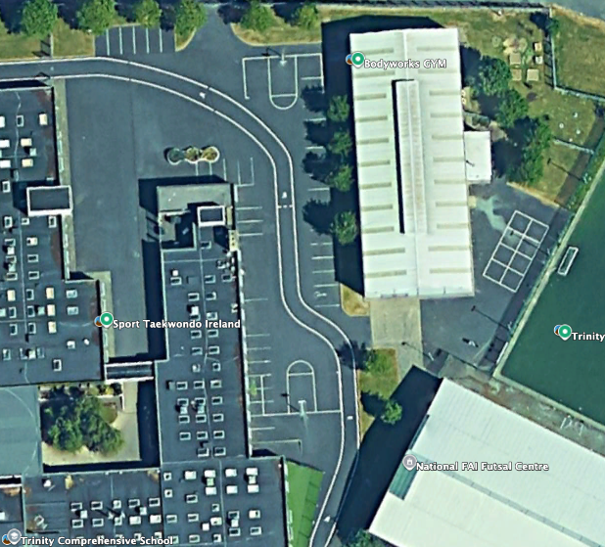

Northing/Latitude
 | 15
 | 14
 | 13
 | 12
 | 11
 | 10
 | 09
 | 08
 | 07
 | 06
 | 05
 | 04
 | 03
 | 02
 | 01
 | 00
 |  | 00 | 01 | 02 | 03 | 04 | 05 | 06 | 07 | 08 | 09 | 10 | 11 | 12 | 13 | 14 | 15
 |  | Easting/Longitude
Overview - 30-180 mins Activity
Using the Walkie Talkie the Scout PLs or Cub Sixer or a leader must guide their Patrols/sixes to find the hidden callsign cards around the site. They are the Command leader
The APL or search team lead receives the grid location directions and clue from the PL or leader and leads the search team to look for the hidden card.
Only the Command Leader map has this map with the card locations & clues. The Search Leader map only has high level grid squares with no details
Command Leader will stay at command HQ and will direct their Search Leader with the search team (via walkie talkie to lat/long of each code to be retrieved as efficiently as possible – route plan.
The use of phonetic alphabet and good radio practice to direct their search team to main grid square gains extra points. e.g. Go to grid Latitude 11 longitude 02 would be called out ”Search team, Go to Grid Latitude 11 longitude 02 and await further instructions, QSL? over”. The search team reply should be “ QSL, Search team to Grid Latitude 11 longitude 02 and await further instructions, over” –good communication and radio practice.
When the search team arrives at the grid square they call the Command leader “”Search team, at Grid Latitude 11 longitude 02 awaiting further instructions, QSL? Over”. The Command leader then has to guide the search team to where the codes are hidden on their map using the clues on their sheet as necessary. –good communication and radio practice.
Each member of the search team(agents) must pass at least one callsign back and spell their name using phonetic code (Alpha, Bravo, Charlie etc) to the search Commander at the other end of the radio. –good communication and radio practice. Red team red codes, blue team blue codes etc.
Both the Search commander and search leader make note of each agent name & code communicated on their check sheet. – Attention to detail
Once all codes are radioed back to Command HQ the Search team returns to command HQ to have their team score checked. 5 points are scored for each code and agent name that match on the Search Leader and Command Leader. 5 points are scored for the 1st team back with all codes correct, 4 for 2nd, 8 for 3rd etc
Radio communications will be monitored and an extra 10 points will be awarded for the use of phonetic code and good communication/radio use. With 5 points for the next best team. However, beware! Up to 10 points will be deducted for any messing or bad language.
The winners might be given a prize – evening off camp wash up, badge , treat etc as appropriate
1
N
Command post
4
3
5
8
10
2
6
7
9
Note: With multiple teams it is good to set each teams walkie talkies to a different channel

Slide 30
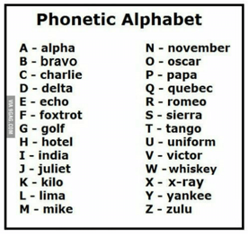
Command - Scout PLs or Cub Sixer or a leader log Team/colour:
# | Direction Clue | Easting/ Longitude | Northing/ Latitude | Call Sign | Scout name | Call sign Country Optional* (Check Qrz.com)
1 | You probably wouldn’t shoot hoops from this far down! | 072 | 150
2 | A small pitch full of fun | 035 | 060
3 | What’s behind ADHD anyway? | 049 | 108
4 | Maybe the Elephant can see behind the tree? | 095 | 120
5 | I could take 3 years to find it here | 010 | 101
6 | You need light on the big pitch to score! | 147 | 055
7 | You might be sitting on it! | 001 | 022
8 | Electric recycling! | 040 | 088
9 | Strictly no code here See See Tee Vee! | 075 | 011
10 | Anyone for tennis? | 035 | 077
11
12
Some Q-Codes
“QSL?”= Did you hear me – “QSL QSL!”= Yes I heard you or “Negative again again” if you didn’t and need the other party to repeat the message
QTH = Location
“What is your QTH?” = What is your location
Good radio operations
1.) Listen and wait for other operator to finish
2.) Wait half a second after pressing the transmit button before speaking
3.) Say “over” at the end of your communication so the other operator knows you have finished speaking
4.) Say “ Say again please, over” if you need the other operator to repeat what they said.
5.) When you repeat your message confirm you have been heard by adding QSL? E.g. My message was “go to Deserted shacks - Latitude 11, Longitude 02, QSL?” QSL means did you hear me?
6.) If you have heard the repeated message you answer saying QSL twice and repeating back the message and over. e.g. “QSL, QSL Go to Deserted shacks Latitude 11, Longitude 02, Over”
7.) Scout leaders/game supervisor listen in an award points for good radio operation
Note: Trust you map reading! There maybe some intentional mistakes in the lat/long columns or no Lat long at all on this sheet ☺
With multiple teams it is good to suggest that each team starts at different locations e.g. Blue team start at Callsign 1, then 2,3 etc. Red team start at Callsign 10, then 9,8 etc Green team start at Callsign 5, then 6,7 and back to 1,2,3 etc
* While search team is moving between locations, if there is a computer and web browser available, the PL/Sixer can look up the callsign on qrz.com and see details like the operators country etc.

Slide 31
Stage 1 - Competency Statements
I can name the things I know that use radio waves
I know my parents/guardian/ICE contact phone number and can dial it on a mobile phone
I know the difference between Commercial and Amateur radio
I can name some radio stations I can hear from my home/den/car
I Know why Amateur Radio is a licensed activity
I know some aspects of the language of radio (Q code , phonetic Alphabet, callsigns), I know what the callsign prefix for my own country is and I can spell my name using the phonetic alphabet
I know what morse code is
I know how to use a walkie talkie properly
I understand the limitations of using a walkie talkie

Slide 32
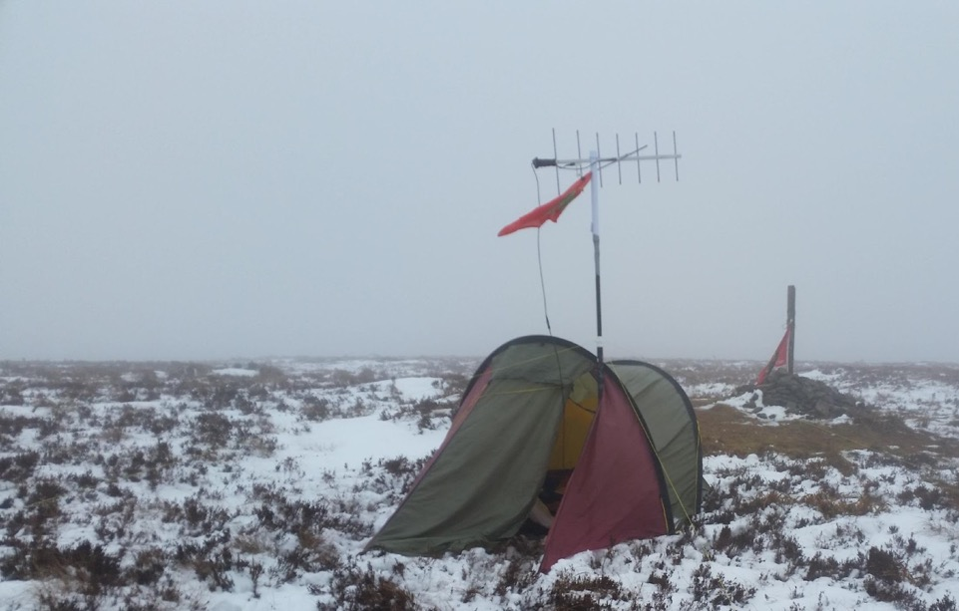
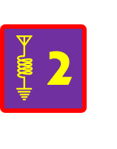
Radio Scouting Skills Stage 2

Slide 33
Stage 2 - Competency Statements
I know what a circuit and an EMF is and I have built a simple circuit e.g. Artibot-scribble robot, morse key, fan and observed how a circuit affects a compass
I know where Sound, Radio and Light frequencies are with regard to the Spectrum of Electro Magnetic Frequencies
I know the main parts of an Amateur Radio Station – Antenna, PSU, receiver, transmitter etc
Know what short wave listening is and I can recognize morse code, data and voice signals
I know what the RST system for signal reporting is
I know how to look up a callsign on qrz.com and I know how to log a QSO
I have listened to and tuned a radio, identified morse code, data and voice signals, logged 5 voice stations/QSO’s and have identified the operators country
I have operated an amateur or marine radio and given my name and station callsign using the phonetic alphabet and spoken on the radio to another operator

Slide 34
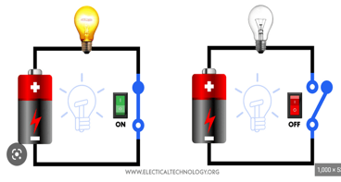
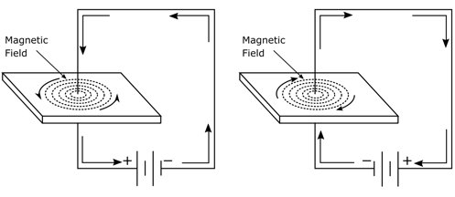
Electric Circuits & Electro Magnetic Fields
A circuit is a closed loop that electricity can travel in.
A source of electricity, such as a battery, provides the electrical energy.
A switch turns the circuit on and off
The “load” a bulb, a buzzer, a motor etc. is what we want the circuit to do.
When an electric current flows in a circuit it also generates an electro magnetic field
This can be demonstrated by putting a compass inside the circuit
We can also use magnets with conductors to generate electricity and create motors as well as microphones, loudspeakers and even radio waves!
Where there is electricity flowing there is an EMF.

Slide 35
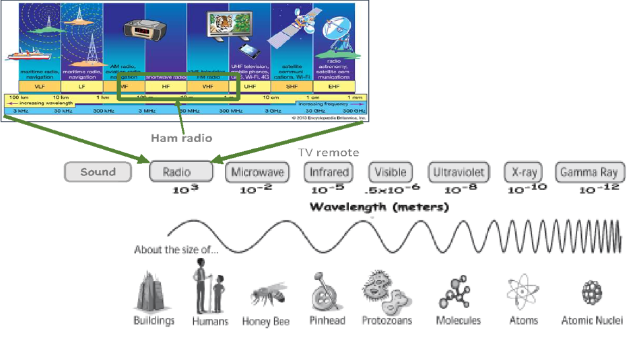
The Spectrum of Electro Magnetic Frequencies
Ionising – Generally Very Dangerous
Most waves in the Audio range are physical waves*
Non-ionising – Generally not dangerous unless very high power
*https://hypertextbook.com/facts/2001/ElizabethWong.shtml#:~:text=However%2C%20it%20has%20been%20discovered,Low%20Frequency%20(ULF)%20range.

Slide 36
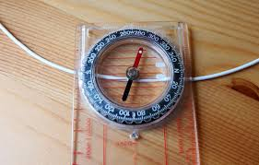
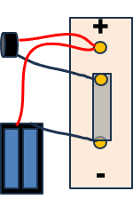
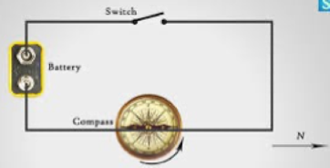
Lets play! – Learn by doing
Demo EMF with Compass and Batteries
Observe how an electric current creates a magnetic field that influence a compass bay shorting 9v battery leads beside a compass.
Build a simple morse code sender circuit with a power source (Battery), switch (Tin Foil “key”) and load (buzzer)
Build and test your circuit – send SOS in morse – Can you send from yours to someone else’s station?
+
-

Slide 37
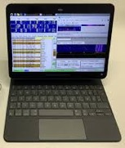
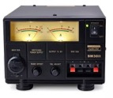

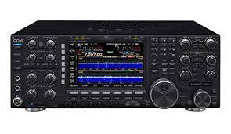
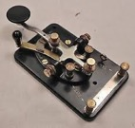

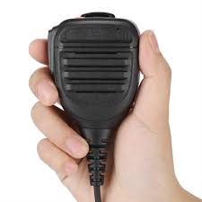
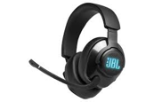
The basics of how a radio works…..
Power
Supply
(PSU)
Controls for bands, audio volume, filters etc
Antenna radiates signal into atmosphere
Transceiver – Transmitter & Receiver
Audio modulated
Onto radio wave
Data
Audio
CW
Antenna collects tine electrical signals from the atmosphere. These are typically transferred via co-axial cable to the Transceiver
Radio Demodulates and amplifies signal and plays through speaker or headphones
Tuning / VFO control to select frequency/ signal
Voice
Transmit (Tx)
Recieve (Rx)

Slide 38



Shortwave Listening
Shortwave listening, or SWLing, is the hobby of listening to shortwave radio broadcasts both Commercial and Amateur
Listening set ups can vary from simple to very elaborate!
Listeners range from casual users seeking international news and entertainment programming, to hobbyists immersed in the technical aspects of long-distance radio reception (DXing)
QRZ.com is the biggest global directory of radio amateurs
You can get started SWLing for free with software defined radios on the internet one of the main SDR’s is Hack Green
1.) Download and install Firefox web browser
2.) Search for Hackgreensdr or type in http://hackgreensdr.org:8901/
3.) Best Ham Radio frequencies to start and get familiar with listening and logging are: 7050-7200 Khz – The 40m Band and 14101-14350 Khz – The 20m Band
4.) Listen & identify Morse/CW, Data and voice modes
5.) Practice logging calls
Click on signal in waterfall to listen in
Use the + and – buttons in the frequency box or your mouse to tune if needed

Slide 39




Signal Reporting
Signal reporting allows operators understand how well their signal is being received and can also support the study of antenna design and propagation
Signal strength is measured on an exponential scale in Decibels - Db
Db measurements are complex, and don’t measure readability. A simple R-S-T system is often used by amateur radio operators, shortwave listeners, and other radio hobbyists to report signals
R=Readability 1-5, S=Signal Strength 1-9, T= Tone 1-9 (Morse/CW only)
Examples: for a voice communication 59 means excellent readability and excellent signal strength a 599 report for CW means means excellent readability, excellent signal strength and excellent tone.
Some times in competitions where time is of the essence SSB operators if they here you will always give a 59 regardless of how well or badly they receive your signal and CW operators in competitions will nearly always send 5NN, Can you guess why?
With data communications some programs report the signal strength in Db

Slide 40





Call sign directories and logging
In the early days of amateur radio it was a mandatory license requirement to log all calls/QSO
Some operators still do ‘paper logging’ but most use software
There are a number of online directories and logging applications, some specialize in different aspects of the hobby, for example competitions, SOTA, POTA etc
The most popular is a web-based directory called QRZ.com and one of te most popular logging programs is Log4OM
Anyone can use QRZ.com to look up a call sign
The following is an example of the sort of information typically logged
 | Callsign | QTH | Op name | Time | Mode | Signal RST | Notes
1 | EI0RSI | Ireland | John | 22.10 | SSB | 57 | Scout station
2
3
4
5

Slide 41
Using the Radio Activity
Using an online Software Defined Radio (SDR) like hack green on a computer or physical Radios, tune the radio and:
Identify morse code, data and voice signals
Identify and listen to 2 Amateur Radio station transmissions, look them up on qrz.com and log their details in your log including:
  Callsign
  Country the person is from
  The Callsign and country of a station who replied if heard
  Place a pin in the world map identifying where the station is located
3.) Now using one of our radios, call or answer CQ using our call sign and have a short QSO logging the details on your log sheet

Slide 42






EI10JOTA - Ham Radio Mission Impossible Cyber Attack!
SITUATION BRIEFING: There has been a huge cyber-attack. All international telecoms and internet has been disabled and local networks are overloaded. The government has activated AREN – The Amater Radio Emergency Network
YOUR COUNTRY NEEDS YOU! YOUR MISSION, SHOULD YOU CHOOSE TO ACCEPT:
Establish what countries the government can communicate with via ham radio by:
Listen, tune & identify CW, DATA, SSB and broadcast radio stations (See interesting frequencies chart)
Listen & Log a QSO as an SWL in Log4OM – Short Wave Listener
Fill in the 1st QSO sheet, write out your name phonetically & some details about you
Call CQ CQ this is Echo Indio One Zero Juliet Oscar Tango Alpha, Echo Indio One Zero Juliet Oscar Tango Alpha, standing by and listening. Make and log as many QSO’s as you can in the time you have on the radio
Look up and log the station callsign of stations that answer your call and pin your team colour on the world map for each contact made
There will be a badge for all who make a QSO and a prize of an RSI mug for best operator as voted by the team!
Notes:
Get details from Stuart

Slide 43
Stage 2 - Competency Statements
I know what a circuit and an EMF is and I have built a simple circuit e.g. Artibot-scribble robot, morse key, fan and observed how a circuit affects a compass
I know where Sound, Radio and Light frequencies are with regard to the Spectrum of Electro Magnetic Frequencies
I know the main parts of an Amateur Radio Station – Antenna, PSU, receiver, transmitter etc
Know what short wave listening is and I can recognize morse code, data and voice signals
I know what the RST system for signal reporting is
I know how to look up a callsign on qrz.com and I know how to log a QSO
I have listened to and tuned a radio, identified morse code, data and voice signals, logged 5 voice stations/QSO’s and have identified the operators country
I have operated an amateur or marine radio and given my name and station callsign using the phonetic alphabet and spoken on the radio to another operator

Slide 44

Engaging with Amateurs & Clubs
Like scouters, some amateurs can be very very passionate about their hobby and love showing it to anyone even vaguely interested!
Amateur radio can go from very basic and simple to literally Phd levels of complexity!
Some may find it hard to simplify and may have little or no experience teaching youth
Explain what you need for a good experience for the youth members - plan-do-review
There are about 2,150 licensed Hams and 75 clubs in Ireland, some very specialised
The National organisation is the Irish Radio Transmitters Society (IRTS) founded in 1932
Many know nothing about the scouting method - Learning by doing, gamification, challenges etc

Slide 45
First and Foremost - Safety Briefing
In doing our risk assessment Your Group Name has identified the risk of accidents as well as the risk that there will be voluteers who may not have had safe-guarding training, be vetted or used to volunteering in the company of children. This short guide has been written to keep you and the children attending the event as safe as possible.
•
1.Please ensure you are never alone in the company of any children without a scout leader present
2.Be aware of your responsibility to be a positive role model and conduct yourself in an appropriate way when engaged in Radio Scouting activities.
3.Never use bad language or make any sexually oriented jokes, talk or actions.
4.No matter what their ability, treat all children with respect and dignity at all times
5.A key element in ensuring children’s safety, is that they are supervised appropriately at all times. Always make sure there are scout leaders around
6.If any child needs or asks for help in anyway, refer them to the nearest scout leader
7.If you have concerns for the safety of any child call the Scouting Ireland 24/7 Child Protection phone service (01) 5547840 if a child is in imminent danger call the Garai on 999
8.Read and understand the Risk assessment & Method statement – ask questions if anything unclear
9.If you have an accident, witness an accident, feel ill or need help in anyway we have a REC 3 trained key contact on the Mission Impossible Base
10.Please note this is is a no smoking & No drinking event
11.Please also read the risk assessment and if you have any questions ask the event lead Name & Mobile

Slide 46


Activity Briefing for Ham Volunteers
This is the youth experience we are aiming for!
Always keep safeguarding at the top of your agenda
Start with a brief intro to the very basics of Radio – the language of Amateur Radio, context, cheat sheets etc
Less talk and more doing! It is not much fun standing around watching someone operate, make it as interactive as possible for example get them to tune around the band, find CW, data, SSB and commercial stations. Get them to log and look up callsigns, get them to call CQ…. They can call CQ in a group, they love that! Get them to pin stations heard ona world map
Gamification - Try as much as possible to make games e.g. Code Hunt, Mission Impossible etc
QSO Cheat sheets – Get them to write out their name using the Alpha Numeric alphabet
1st QSO badges – really helps combat mic shyness
Make a note of anyone that really impresses…for prize/mention! :-)

Slide 47
Thank you for attending Stage 1 & 2 training!
We would welcome your feedback & Questions. Please complete this short survey.

Slide 48
Radio Scouting Stage 3 + Teaser

Slide 49
Stage 3 - Competency Statements
I have taken part in JOTA-JOTI
I understand low frequency, high frequency, HF, VHF & UHF
I understand low frequencies need larger antennas and high frequencies need smaller antennas
I understand resonance and the basics of tuning a half-wave dipole antenna
I understand the concept of signal-to-noise ratio and how directional antennas help
I understand and can explain the 3 modes of propagation, namely Free-space, Groundwave & Ionospheric prorogation
I can explain why I can hear distant stations on MW, LW and SW and how these changes from night and day
I know how space weather, particularly the Sun affects radio wave propagation
I know what objects in the Solar System emit radio waves and I understand the concept of signal to noise ratio
I understand what a repeater is and I have made a QSO via a repeater
I understand the main radio controls and how to use them, VFO A/B, AGC, RF gain, AF gain, Band select, Mode select, Tune
I have a log of 25 shortwave/HF stations that I have heard on the radio (Can includes Amateur and Commercial Stations). Log time, date, frequency, mode and signal report
I have used an amateur radio station under supervision & completed and logged 5 QSO’s
I have received a QSL card from a commercial or Amateur radio station
I know the meaning and use of Mayday, PanPan and Securite, I can use radio communications effectively in an emergency situation and I know how to contact emergency services using Marine VHF

Slide 50



