Slide 1

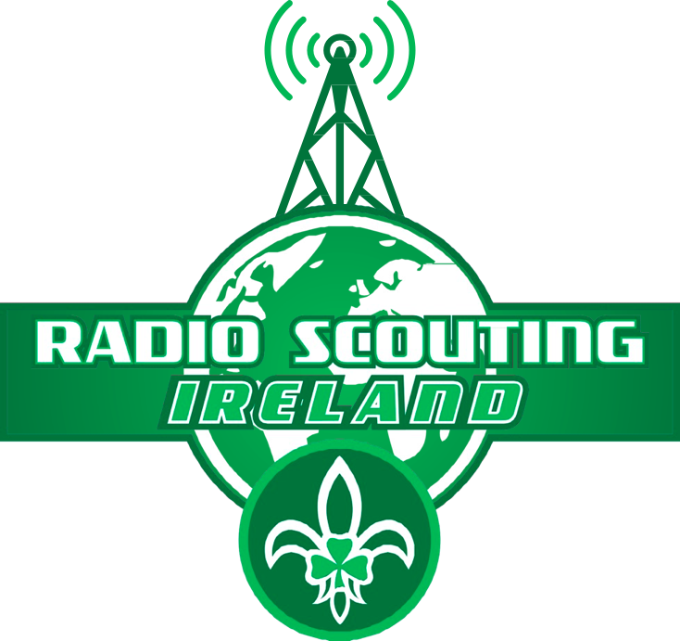
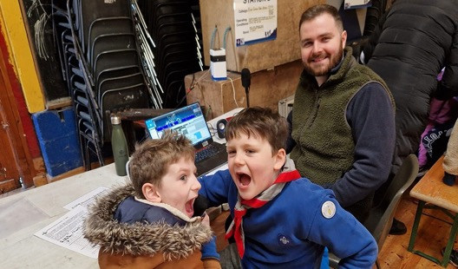

Welcome to the Introduction to Radio Scouting and the Radio Scouting Skills Programme level 1 &2 training

Slide 2


1st ever Radio Scouting Skills training course
1st time for us giving the course
Bound to be a few errors and we may not have our timing right! Apologies in advance!
About 2 years of work by the team developing the full program
Feedback really appreciated….. be gentle though!!! ;-)

Slide 3
Today’s Agenda
Time | Topic | Lead
09.30-10.00 | Registration, Tea and coffee, introductions | ALL
10.00 - 10.20 | Introduction to Radio Scouting & JOTA-JOTI | JH
 | Radio Scouting Ireland's role & Radio adventure skills program pilot
 | Introduction to Ham Radio
10.20 - 11.00 | Radio scouting stage 1 | AW
11.00 - 11.15 | Break
11.15 - 12.00 | Simple radio activities: X's & O's, Hang Man games | ALL
12.00 - 13.15 | Lunch
13.15 -14.15 | Radio code hunt Game | AC
14.15 - 15.15 | Radio scouting Stage 2 | JH
15.15- 16.00 | Electric circuit and compass activity, Mission Impossible HF radio game | All
16.00-16.30 | Wrap up, Q&A and feedback | All

Slide 4
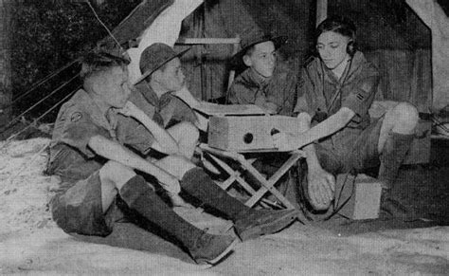
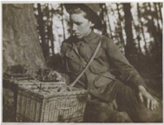
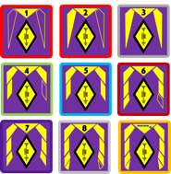
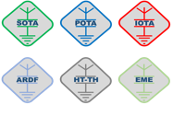





Radio Scouting/Radio Guiding
Radio Skills have been a fun and educational part of scouting and guiding since at least 1918
Ham Radio or Amateur Radios is a big part of Radio Scouting
Many countries have well-established radio scouting programs
The biggest annual scout and guide event is JOTA-JOTI
Radio Scouting Ireland (RSI) was set up to support scout and guide groups who want to take part in JOTA-JOTI and do radio/STEM and there are lots of free resources at www.radioscouting.ie/resources
RSI have developed an adventure skills program with SI with many badges for different levels of achievement and participation:
  S1-S9 Program Badges up to license level (Pilot)
  Licensed Operator & Special Interest badges (Pilot)
  JOTA-JOTI badge – Biggest annual scout and guide event

Slide 5
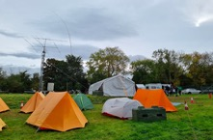
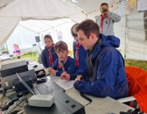
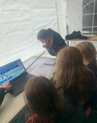
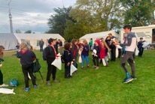
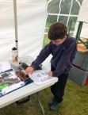
Jamboree On The Air - JOTA
Largest Scouting Event in the World since 1957!
~1-2 Million Scouts operating ~ 13,500 stations in ~ 150 countries take part each year in October
Introduce Scouts to the fun and technology of amateur radio & Radio scouting
Scouts can gain perspective on other countries, other, cultures and other Scouting programs --- by talking to other Scouts around the world
Learn and or improve a new skill – the basics of how to use the radio and make contacts around the world
Earn a JOTA-JOTI participation badge
You might end up with a great lifelong hobby
It might even be the start of a great career!

Slide 6
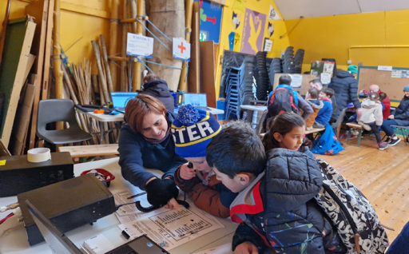
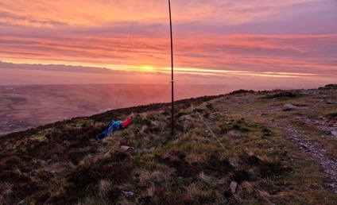
Radio Scouting Ireland's Role
Radio Scouting Ireland – Strategic Ovbjectives 2022-2025
Develop fun radio, communications and electronics activities that are easily achievable by Scout troops around Ireland at their dens and the National Scout Centres - See www.radioscuting.ie
Support scout troops with training
Support national events
Development and support of a Radio Scouting Program (S1-S9), to support Scouts and Scouters to achieve a solid understanding of science, technology, radio, electronics, operations and regulations.
Lobby and support the establishment of an Irish novice license regime suitable for youth members.
Develop a sponsorship program to create a network of excellent STEM/Radio shack facilities at the main Scout Centres around Ireland
Radio Scouting Ireland also do Garda vetting and safeguarding training for all our members

Slide 7

https://vimeo.com/325220441
Notes:
What is scouting all about
Talk about the value of what we do, getting kids out doors, providing and fun place for kids that don’t fit into the world of sport
How to get involved, leader, parents and friends
We are getting bigger
we have recrutied from within (Fionn)
Need leaders in scouts and venturers

Slide 8
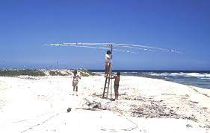

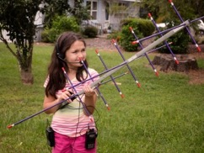
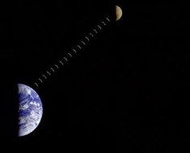
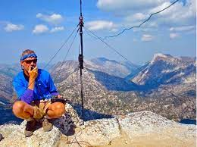
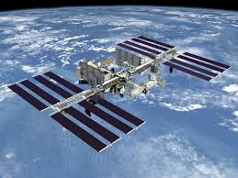


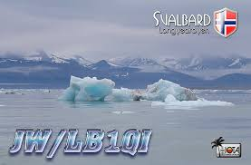
EME (Earth-Moon-Earth)
Contacts all around the world!
Antenna building
Building own radio/electronics
Contesting – Radio sport
Rag chewing (chat)
Direction finding
Voice, Morse (CW) Packet/Data modes
DX communication
DX-pedition
Earth-Moon-Earth
Emergency communications
Morse code
Operating awards
Portable operation
QRP operation
QSL card collection
Satellite communications
Special event stations
Television
Slow scan Television
IOTA -Islands
SOTA -Summits
POTA - Parks
And many more!!!
Ham Radio - lots of fun & interesting things to do!
IOTA – islands On The Air & DXPEDITIONS
Satellite communication
SOTA – Summits On the Air
ISS & ISS repater
Notes:
On VHF contacts are normally line of sight only.
Can be extended to 1000 miles or more with Tropo, various scatter modes
How can we make contacts further out?

Slide 9
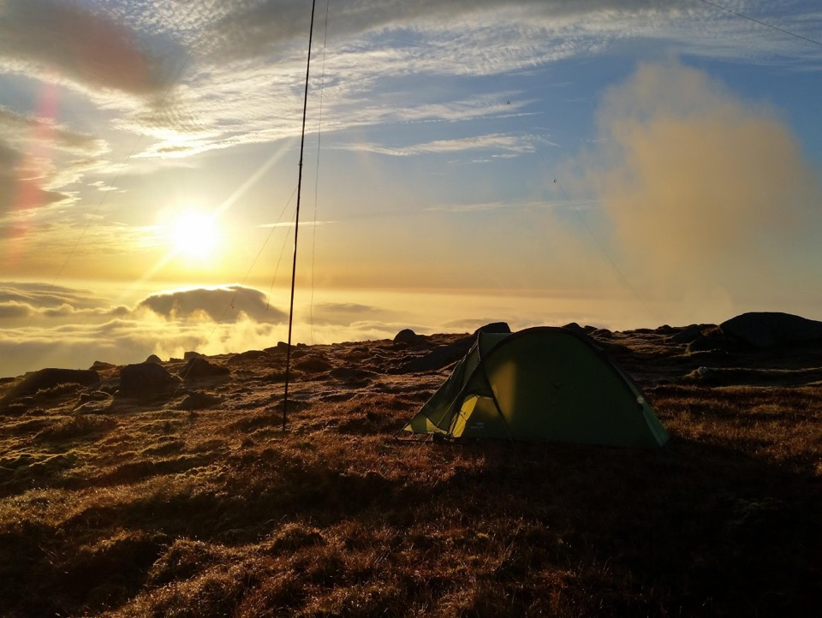
Radio Adventure Skill Pilot
Stage 1

Slide 10
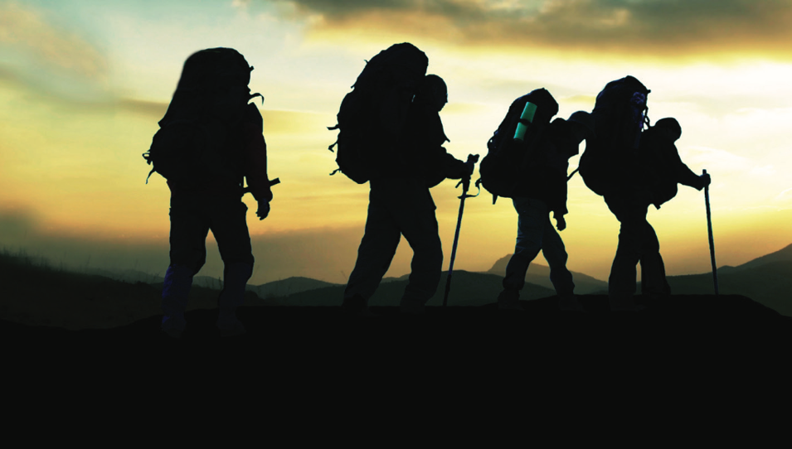
Recap of adventure skills
Presented as Statements of competency - I know how, I can do, etc.
Skills requirement outlines the details of knowledge and experience a Scout is expected to display to fulfil the Competency Statement.
Stages are not aligned to Sections
Competencies need to be assessed.
Stage 1 aims to introduce the skill to where the scout can take an active part

Slide 11
Stage 1 - Competency Statements
I can name the things I know that use radio waves
I know my parents/guardian/ICE contact phone number and can dial it on a mobile phone
I can name some radio stations I can hear from my home/den/car
I know the difference between Commercial and Amateur radio
I Know why Amateur Radio is a licensed activity
I Know what morse code is
I know some aspects of the language of radio (Q code , phonetic Alphabet, callsigns), I know what the callsign prefix for my own country is and I can spell my name using the phonetic alphabet
I know how to use a walkie talkie properly

Slide 12
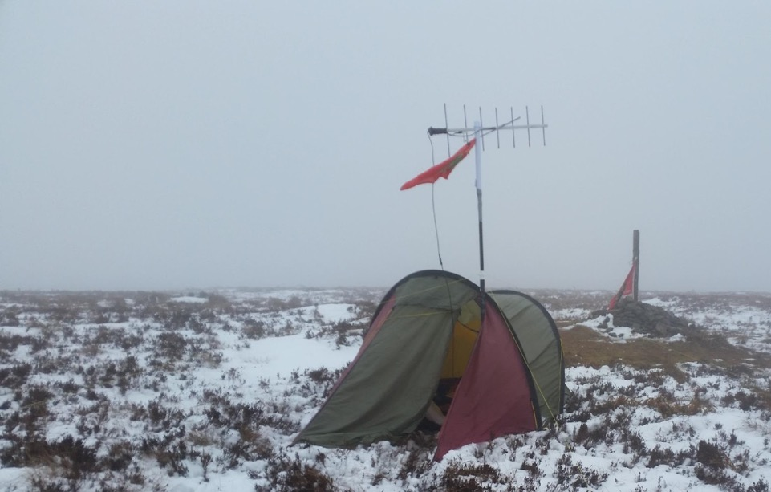
SKILLS REQUIREMENTS

Slide 13
I can name the things I know that use radio waves
Scouts should discus the things they know that use radio waves
Discussion should include similarities and differences between them including range and operation.
E.g. Walkie Talkies, Car radio, TV, WiFi, GPS, Bluetooth, Radar, baby monitors, satellite dishes
Range: Over what distances do they work? How far away do you have to go from a phone for a Bluetooth speaker to stop working?
Two – way: What things are using two way communication and which are one way?

Slide 14
I know my parents/guardian/ICE contact phone number and can dial it on a mobile phone
Scouts should know their ICE contact number
Scouts can demonstrate that they can use a mobile phone to call someone. They can borrow a scouters phone to call another scouter.
Scouts should know the Emergency Services Numbers
Scouts should know that even if they don’t have a mobile signal they may still be able to call the Emergency Services

Slide 15
I can name some radio stations I can hear from my home/den/car
The Scout should experiment with an FM or AM radio in their den and be able to tune around to different stations.
Listen to some of the stations for a while and identify their name and where they broadcast from.
Create a ‘Band Plan’ of some of the stations you can hear. List:
  The frequency the operate on
  Their name
  Type of programming (news, music, sports etc.)
If FM and AM radios are available compare and contrast the stations heard

Slide 16
I know the difference between Commercial and Amateur radio
Scouts should be introduced to listening to Amateur Radio. This can be done with a amateur radio set, an RTL-SDR, or a web based SDR.
Scouts should discuss the difference between these communications and the commercial stations they listened to.
  We recommend the Hack Green Web SDR http://hackgreensdr.org:8901/ located in a former R.A.F Nuclear bunker!
  Web SDR can be used to listen to worldwide commercial radio also.
  Amateur radio: people talk to each other, or send 2 way messages, signals not as strong, signals not a clear, no music
  Commercial Radio: One way communication, stronger signal, often contains music

Slide 17
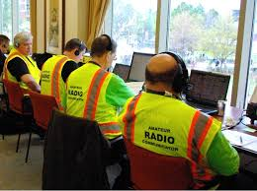
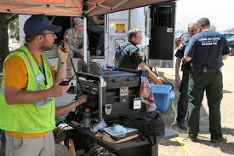
Scouts should know Amateur radio requires a license
Why is Amateur Radio a licensed hobby?
Using radio transmitters can be dangerous.
  Can cause interference to flight control, blue-light services etc.
  Can cause shock and burns
  Governments want to ensure licensed amateurs know what they are doing!
Licensed amateurs are a very important resources during natural disasters in many countries. Governments need to know who their amateurs are in case of emergencies. Licensed Amateurs often provide back-up communications to cellular, internet and blue light communications in disaster scenarios.
Notes:
On VHF contacts are normally line of sight only.
Can be extended to 1000 miles or more with Tropo, various scatter modes
How can we make contacts further out?

Slide 18
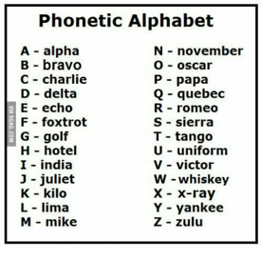
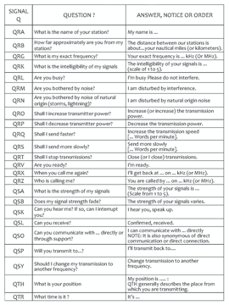
Scouts should know radio has a language
Many hobbies and sports have their own language words & code for example Scouts have Jamboree’s, woggles, neckers, Moots etc, golf has birdies, bogies, Eagles, holes in one, fades, slices etc.
Because radio reception can be very variable hams regularly use code to help with effective and accurate communication
For example:
  We use Q-code, Morse Code, The phonetic Alphabet
  A basic contact is called a QSO!
  To call on the air we say CQ CQ maybe short for Seek You Seek You!
  We use call signs which identify the radio station and country for example EI3ISB EI10JOTA
Would anyone like a go at phonetically spelling and guessing the country of these following call signs?
FR9AA IK2VCV VK7AC DL4TP ZL4AD SP9CQ
Q Codes & Shorthand
QSO – A call with another station
QSL? – Can you hear me
QSL QSL – Yes I heard you
Your QTH – Your Location – Dublin
QRZ? – Who is calling me?
73 – Best wishes
You are 59 – I Hear you loud and clear

Slide 19
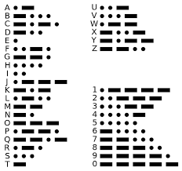
Scouts should know what CW/Morse code is
Morse code, often refered to as “CW” (Continuous Wave) is named after it’s inventor Samuel Morse is a way of sending messages efficiently using simple communications devices.
The first digital signalling system
Morse code is made up of “dit” (dot) and “dah” (dash). The duration of a dah is three times the duration of a dit.
Below is a list of morse codes for the alphabet, numbers and punctuation.
‹#›

Slide 20
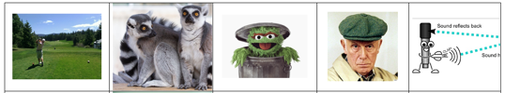

I can spell my name using the phonetic alphabet
Scouts should be familiar with the phonetic alphabet and be able to spell their name using it.
There are a variety of games that can be used to teach this skill

Slide 21
Lets play! – Learn by doing
Pair into groups of two or more, read the game instructions and have some fun while learning to use the walkie talkies, sometimes referred to as handie talkies!
X’s & O’s
Hangman
Lego

Slide 22
Lunch Break

Slide 23
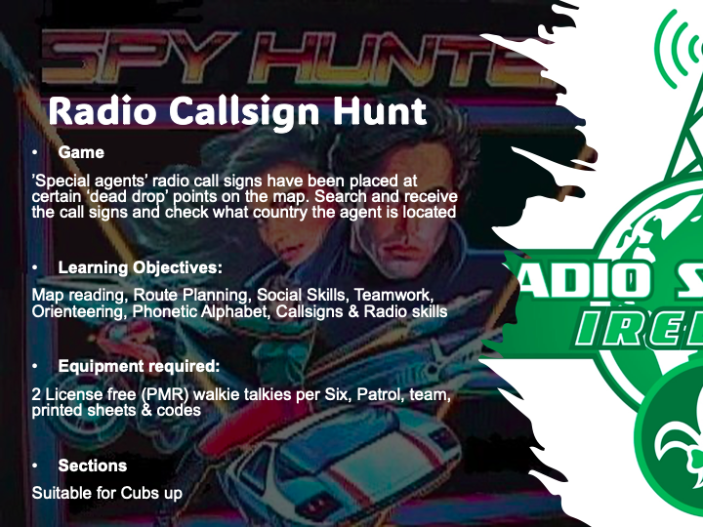
Lets play! – Learn by doing
Pair into groups of two or more, to play!

Slide 24
Stage 2 - Competency Statements
I know what a circuit and an EMF is and I have built a simple circuit e.g. Artibot-scribble robot, morse key, fan and observed how a circuit affects a compass
I know where Sound, Radio and Light frequencies are with regard to the Spectrum of Electro Magnetic Frequencies
I know the main parts of an Amateur Radio Station – Antenna, PSU, receiver, transmitter etc
Know what short wave listening is and I can recognize morse code, data and voice signals
I know what the RST system for signal reporting is
I know how to look up a callsign on qrz.com and I know how to log a QSO
I have listened to and logged 5 QSO’s and have identified the operators country
I have taken part in JOTA-JOTI or other scout or youth event and spoken on the radio to another operator

Slide 25
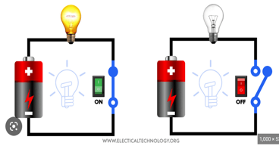
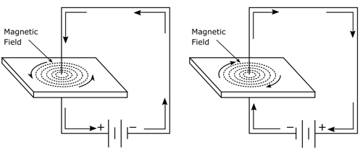
Electric Circuits & Electro Magnetic Fields
A circuit is a closed loop that electricity can travel in.
A source of electricity, such as a battery, provides the electrical energy.
A switch turns the circuit on and off
The “load” a bulb, a motor etc is what we want the circuit to do.
When an electric current flows in a circuit it also generates electro magnetic waves
This can be demonstrated by putting a compass inside the circuit
We can also use magnets with conductors to generate electricity and create motors as well as microphones, loudspeakers and even radio waves!

Slide 26
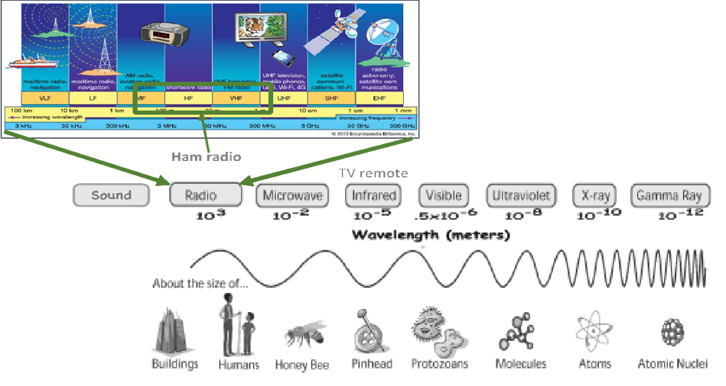
The Spectrum of Electro Magnetic Frequencies
Ionising – Generally Very Dangerous
Most waves in the Audio range are physical waves*
Non-ionising – Generally not dangerous unless very high power
*https://hypertextbook.com/facts/2001/ElizabethWong.shtml#:~:text=However%2C%20it%20has%20been%20discovered,Low%20Frequency%20(ULF)%20range.

Slide 27
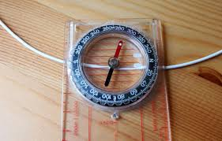
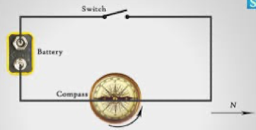
Lets play! – Learn by doing
Pair into groups of two or more and read the instructions to
Observe how an electric current can influence a compass bay shorting 9v battery leads beside a compass.
Build a simple circuit with a power source (Battery), switch and load (motor, buzzer, led or light)
Build and test your circuit

Slide 28
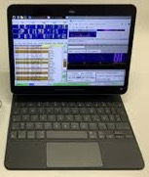
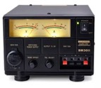

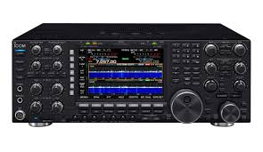
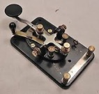

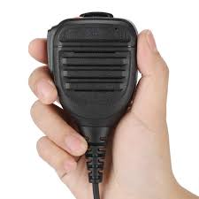
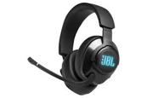
The basics of how a radio works…..
Power
Supply
(PSU)
Controls for bands, audio volume, filters etc
Antenna radiates signal into atmosphere
Transceiver – Transmitter & Receiver
Audio modulated
Onto radio wave
Data
Audio
CW
Antenna collects tine electrical signals from the atmosphere. These are typically transferred via co-axial cable to the Transceiver
Radio Demodulates and amplifies signal and plays through speaker or headphones
Tuning / VFO control to select frequency/ signal
Voice
Transmit (Tx)
Recieve (Rx)

Slide 29

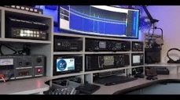

Shortwave Listening
Shortwave listening, or SWLing, is the hobby of listening to shortwave radio broadcasts both Commercial and Amateur
Listening set ups can vary from simple to very elaborate!
Listeners range from casual users seeking international news and entertainment programming, to hobbyists immersed in the technical aspects of long-distance radio reception (DXing)
QRZ.com is the biggest global directory of radio amateurs
You can get started SWLing for free with software defined radios on the internet one of the main SDR’s is Hack Green
1.) Download and install Firefox web browser
2.) Search for Hackgreensdr or type in http://hackgreensdr.org:8901/
3.) Best Ham Radio frequencies to start and get familiar with listening and logging are: 7050-7200 Khz – The 40m Band and 14101-14350 Khz – The 20m Band
4.) Listen & identify Morse/CW, Data and voice modes
5.) Practice logging calls
Click on signal in waterfall to listen in
Use the + and – buttons in the frequency box or your mouse to tune if needed

Slide 30
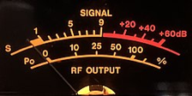

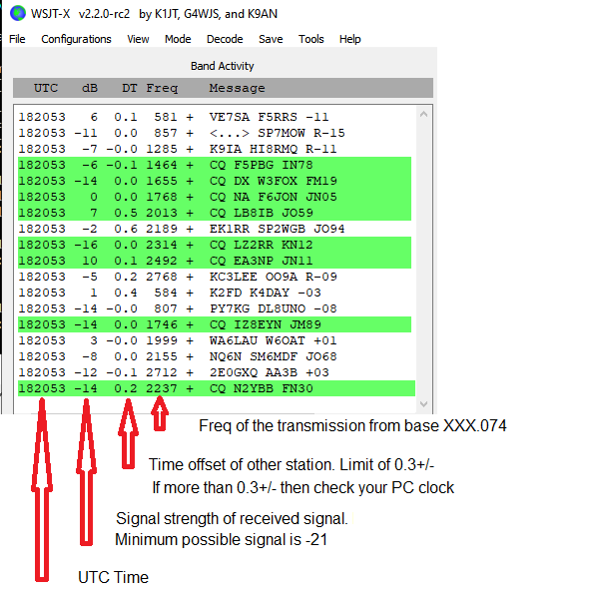
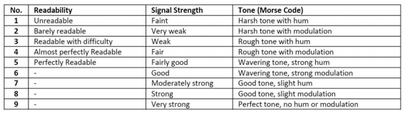
Signal Reporting
Signal reporting allows operators understand how well their signal is being received and can also support the study of antenna design and propagation
Signal strength is measured on an exponential scale in Decibels - Db
Db measurements are complex, and don’t measure readability. A simple R-S-T system is often used by amateur radio operators, shortwave listeners, and other radio hobbyists to report signals
R=Readability 1-5, S=Signal Strength 1-9, T= Tone 1-9 (Morse/CW only)
Examples: for a voice communication 59 means excellent readability and excellent signal strength a 599 report for CW means means excellent readability, excellent signal strength and excellent tone.
Some times in competitions where time is of the essence SSB operators if they here you will always give a 59 regardless of how well or badly they receive your signal and CW operators in competitions will nearly always send 5NN, Can you guess why?
With data communications some programs report the signal strength in Db

Slide 31





Call sign directories and logging
In the early days of amateur radio it was a mandatory license requirement to log all calls/QSO
Some operators still do ‘paper logging’ but most use software
There are a number of online directories and logging applications, some specialize in different aspects of the hobby, for example competitions, SOTA, POTA etc
The most popular is a web-based directory called QRZ.com and one of te most popular logging programs is Log4OM
Anyone can use QRZ.com to look up a call sign
The following is an example of the sort of information typically logged
 | Callsign | QTH | Op name | Time | Mode | Signal RST | Notes
1 | EI0RSI | Ireland | John | 22.10 | SSB | 57 | Scout station
2
3
4
5

Slide 32
I have listened to 5 different stations calling and logged their details
The scout should have listened to Amateur Radio stations and noted their details including:
  Callsign
  Country the person is from
  The Callsign and country of a station who replied

Slide 33
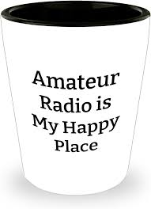
Engaging with Amateurs & Clubs
Like scouters, some amateurs can be very very passionate about their hobby and love showing it to anyone even vaguely interested!
Amateur radio can go from very basic and simple to literally Phd levels of complexity!
Some may find it hard to simplify and may have little or no experience teaching youth
Explain what you need for a good experience for the youth members - plan-do-review
There are about 2,150 licensed Hams and 75 clubs in Ireland, some very specialised
The National organisation is the Irish Radio Transmitters Society (IRTS) founded in 1932
Many know nothing about the scouting method - Learning by doing, gamification, challenges etc

Slide 34
First and Foremost - Safety Briefing
In doing our risk assessment Your Group Name has identified the risk of accidents as well as the risk that there will be voluteers who may not have had safe-guarding training, be vetted or used to volunteering in the company of children. This short guide has been written to keep you and the children attending the event as safe as possible.
•
1.Please ensure you are never alone in the company of any children without a scout leader present
2.Be aware of your responsibility to be a positive role model and conduct yourself in an appropriate way when engaged in Radio Scouting activities.
3.Never use bad language or make any sexually oriented jokes, talk or actions.
4.No matter what their ability, treat all children with respect and dignity at all times
5.A key element in ensuring children’s safety, is that they are supervised appropriately at all times. Always make sure there are scout leaders around
6.If any child needs or asks for help in anyway, refer them to the nearest scout leader
7.If you have concerns for the safety of any child call the Scouting Ireland 24/7 Child Protection phone service (01) 5547840 if a child is in imminent danger call the Garai on 999
8.Read and understand the Risk assessment & Method statement – ask questions if anything unclear
9.If you have an accident, witness an accident, feel ill or need help in anyway we have a REC 3 trained key contact on the Mission Impossible Base
10.Please note this is is a no smoking & No drinking event
11.Please also read the risk assessment and if you have any questions ask the event lead Name & Mobile

Slide 35
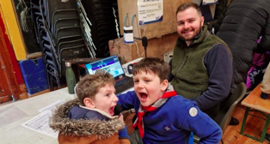

Activity Briefing for Ham Volunteers
This is the youth experience we are aiming for!
Always keep safeguarding at the top of your agenda
Start with a briefing intro to the very basics of Radio – the language of Amateur Radio, context, cheat sheets etc
Less talk and more doing! It is not much fun standing around watching someone operate, make it as interactive as possible for example get them to tune around the band, find CW, data, SSB and commercial stations. Get them to log and look up callsigns, get them to call CQ…. They can call CQ in a group, they love that! Get them to pin stations heard ona world map
Gamification - Try as much as possible to make games e.g. Code Hunt, Mission Impossible etc
QSO Cheat sheets – Get them to write out their name using the Alpha Numeric alphabet
1st QSO badges – really helps combat mic shyness
Make a note of anyone that really impresses…for prize/mention! :-)

Slide 36
Thank you for attending Stage 1 & 2 training!
We would welcome your feedback & Questions

Slide 37
Radio Scouting Stage 3 + Teaser

Slide 38
Stage 3 - Competency Statements
I understand low frequency, high frequency, HF, VHF & UHF
I understand low frequencies need larger antennas and high frequencies need smaller antennas
I understand resonance and the basics of tuning a half-wave dipole antenna
I understand the concept of signal-to-noise ratio and how directional antennas help
I understand and can explain the 3 modes of propagation, namely Free-space, Groundwave & Ionospheric prorogation
I can explain why I can hear distant stations on MW, LW and SW and how these changes from night and day
I know how space weather, particularly the Sun affects radio wave propagation
I know what objects in the Solar System emit radio waves and I understand the concept of signal to noise ratio
I understand what a repeater is and I have made a QSO via a repeater
I understand the main radio controls and how to use them, VFO A/B, AGC, RF gain, AF gain, Band select, Mode select, Tune
I have a log of 25 shortwave/HF stations that I have heard on the radio (Can includes Amateur and Commercial Stations). Log time, date, frequency, mode and signal report
I have used an amateur radio station under supervision & completed and logged 5 QSO’s
I have received a QSL card from a commercial or Amateur radio station
I know the meaning and use of Mayday, PanPan and Securite, I can use radio communications effectively in an emergency situation and I know how to contact emergency services using Marine VHF

Slide 39
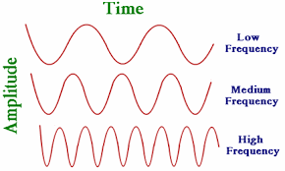
Frequency & Wavelength
Energy can travel in waves through the air – Sound energy, Light energy, Radio
🡨---Wavelength---->
Long Wave Lengths = Low frequencies
Short Wave Lengths = High frequencies
Listen to some high frequency and low frequency Audio waves
Why do you think loudspeakers are different sizes?
What size speaker do you think is best for low frequencies?
What size speaker do you think is best for high frequencies?
https://www.szynalski.com/tone-generator/

Slide 40
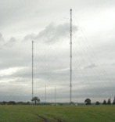

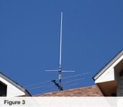
How Does An Antenna Work?
Like a loud speaker can turn an electrical signal and convert it to transmit* Audio waves through the air, an antenna is used to transmit and receive Radio waves.
To be efficient the antenna should be matched or “resonant” on the intended frequency of use. Two lengths of wire ¼ wavelength (λ - Lambda) long resonate well and would be know as a “Half Wave Dipole”
🡨— 1 Wavelength (λ) -->
Big Antenna
(LF – Long Wave)
Medium size antenna 160m-6m
(HF-Shortwave radio)
Small antenna
(Very High Frequency –VHF and Ultra High Frequency UHF)
½ wave dipole - λ/2 dipole
Antenna Feed Point

Slide 41
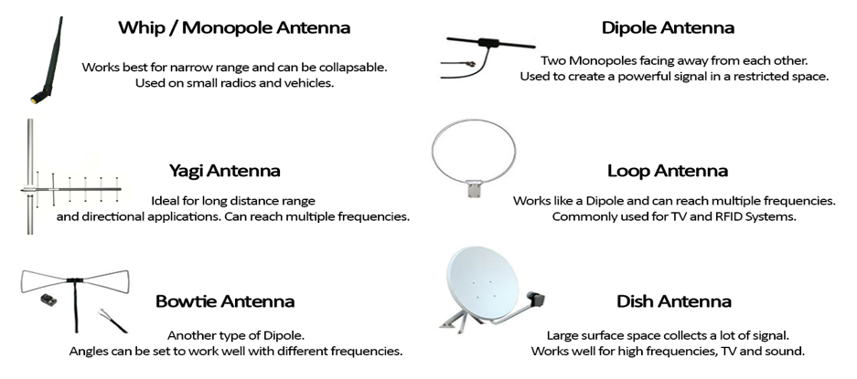
Examples of antenna types

Slide 42
Resonance – Tuning an Antenna

Slide 43
Signal to Noise Ratio & Directivity

Slide 44

Long distance propagation and Skip
Lost in Space
Ducting
Varies a lot over the day, night, season and sun seasons and weather!
Varies with frequency - Minimum Usable Frequency (MUF)

Slide 45
Making a QSO & Logging it
A Basic QSO:
  1.) Press Mic button and Call - CQ JOTA CQ JOTA Echo - India - One - Zero – JOTA
  2.) Listen for callsign replies e.g. DL4TP
  Listen especially for calls with JOTA in the callsign, Like say. Fox-Radio 5-JOTA – They will be other scout troops
  3.) Press the mic button and repeat call sign heard back with “59” or say part of the callsign you heard and “Station Only Please”
  For example if you only heard the 1st or 2nd bit of the callsign DL4TP, Delta – Lima- 4 or Tango –Papa, you should press the mic button and say “Delta – Lima- 4 station only please” or “Tango – Papa station only please”
  4.) Repeat as needed and when you have their callsign write it down, press the mic and repeat it back with 59.
  For example “Delta – Lima- 4 - Tango –Papa 59”. - 59 signifies you have heard them clearly
  5.) They should reply “Echo - India - One - Zero – JOTA 59” indicating they have heard you properly
  6.) If you have lots of stations calling you should then go to the next contact by pushing the mic key and saying “Thank you for the contact 73” which means thank you for the contact best wishes
  7.) If there are not many stations calling you, you can talk some more with them, tell them your name and Scout Troop ID e.g. “My name is Katie – Kilo-Alpha-Tango-India-Echo and our JOTA Id is : 2 India – Quebec – 3-2- Uniform, 2 India – Quebec – 3-2- Uniform”
  8.) They may come back with more info about themselves which you can note in your log.
  9.) Once finished you press the mic and say “Thank you for the contact 73”
Notes:
What is scouting all about
Talk about the value of what we do, getting kids out doors, providing and fun place for kids that don’t fit into the world of sport
How to get involved, leader, parents and friends

Slide 46




You can even make your own efficient 20m Antenna and make contacts around the world with it at JOTTA - JOTI!
Make at home and bring and make on site.
A.) What you Need –Picture 1
1 x Plastic Bottle top
2 x Plastic Bottle top rings
2x 3m lengths of string or twine
2 x 5.05m (TBC) lengths of wire e.g.
  2 lengths of old bell/ telephone or electrical wire
  Halfords 7m spool of speaker wire, wire split in two
  Strip and old LAN cable and use two lengths of the wires inside
B.) Instructions
Make 3 x 5-10mm holes in Bottle top and tie one end of each length of wire to the two outer holes on the bottle top leaving 2” or 5cm of wire spare as illustrated in picture 2.
Strip back ½” or 1.5cm of insulation and twist the wire to stop any fraying as in picture 2.
Twist about 2” or 5cm of the other ends of the wires around the two bottle top rings as illustrated in picture 3.
Tie the two 3m strings to the other side of the bottle top rings as illustrated in picture 3.
Wind up your dipole antenna and bring it to use on the day to test! Picture 4.
1
2
3
4
‹#›

Slide 47


Radio Scouting Adventure Skill Level 1 and Level 2
Scouter Training Program Pilot
Saturday 23rd November 09.30 – 16.30 Kilmacud Scout Den
To register/Book email: radioscoutingireland@gmail.com
Bring your own lunch – Tea and coffee provided

